Slide 1
Feature selection
multicollinearity issues
Pearson correlation coefficient
Variance inflation factor
Forest Fire
Auto MPG
Servo

Slide 2
Pearson correlation coefficient
Calculated for every pair of features
Ranges from 1 and -1
Closer to 0 means less correlated
Away from 0 mean more correlated

Slide 3
Variance inflation factor (VIF) (from statsmodels library)
For i in [0,#features-1] run Ordinary Least Squares (OLS) method with ith feature and rest
Calculate r2 score [0, 1]
VIF = 1/(1-r2 score), ranges in [1,inf]
VIF > 5 is can be considered as a correlated feature [1]
VIF > 5 is warning and VIF > 10 is problematic [2]
To optimize in terms of error we drop features with VIF > 10 only
To optimize in terms of SOC we drop features with VIF > 5
Strategy: dop single feature with highest VIF > 10 at a time, repeat until no feature with highest VIF > 10 is left
r2 | 0 | 0.1 | 0.2 | 0.3 | 0.4 | 0.8 | 0.9 | 0.999 | 1
VIF | 1 | 1.1 | 1.25 | 1.42 | 1.66 | 5 | 10 | 1000 | inf

Slide 4
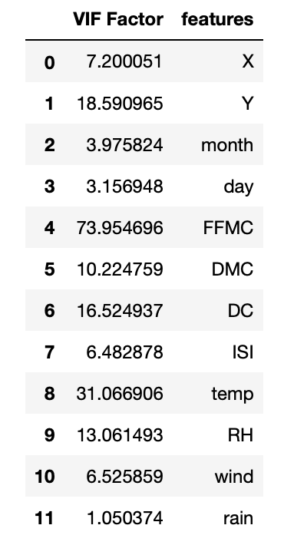
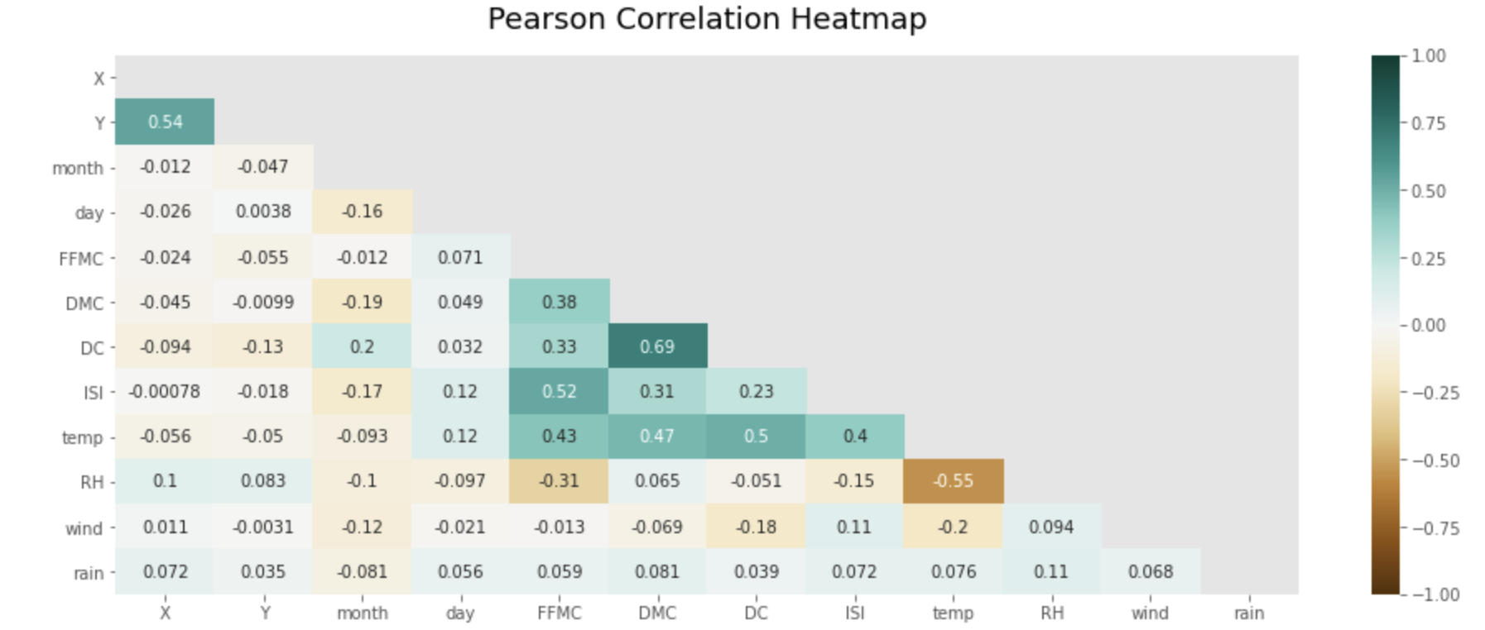
Forest Fire without standard scaler

Slide 5
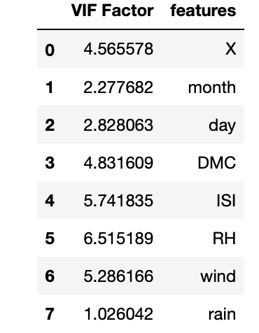
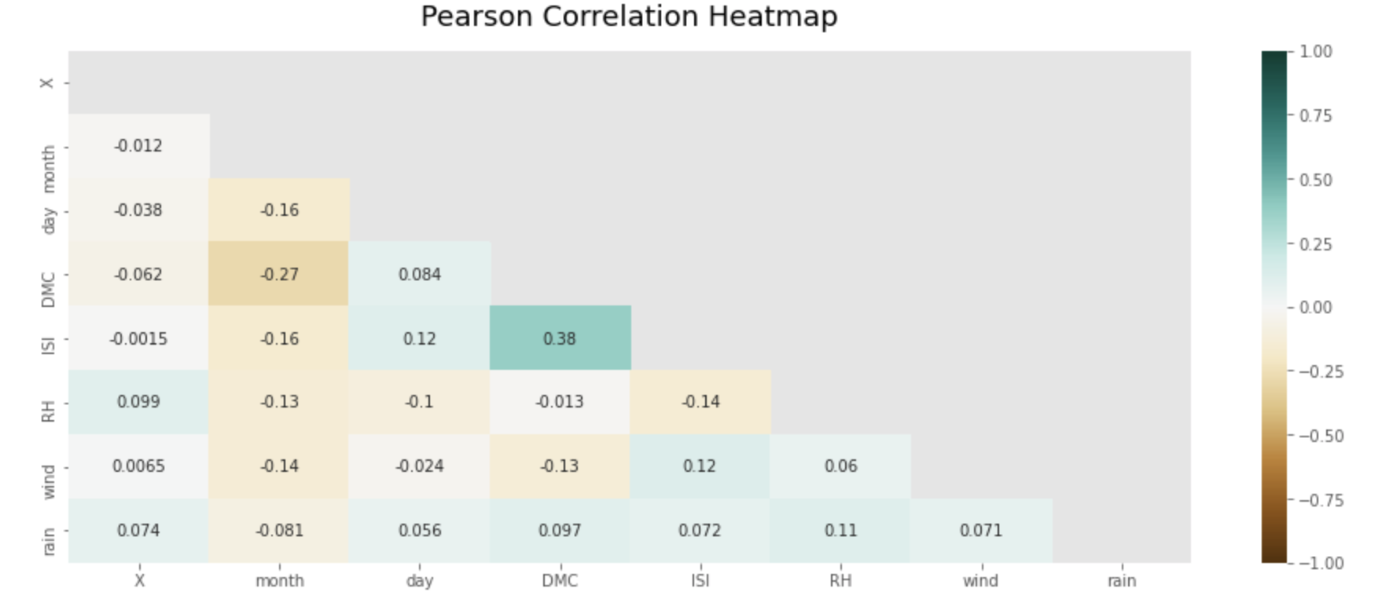
Forest Fire without standard scaler after dropping features

Slide 6
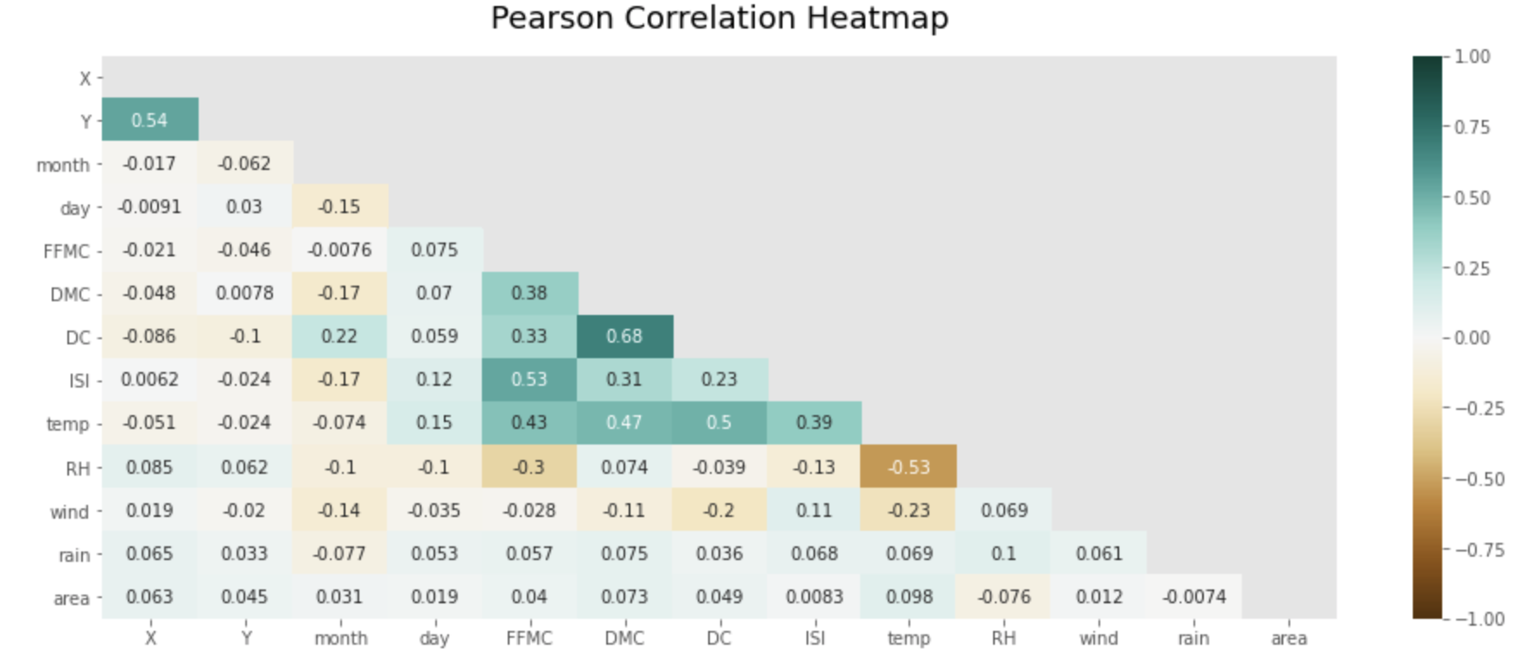
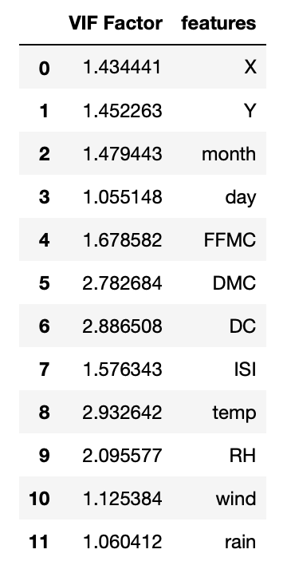
Forest Fire with standard scaler (all features are selected)

Slide 7
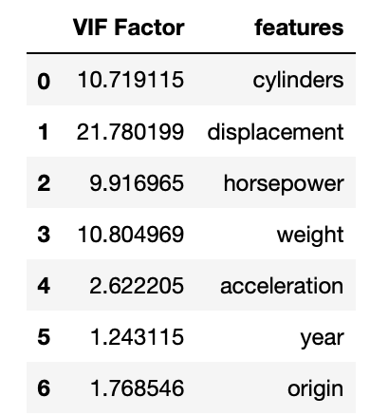
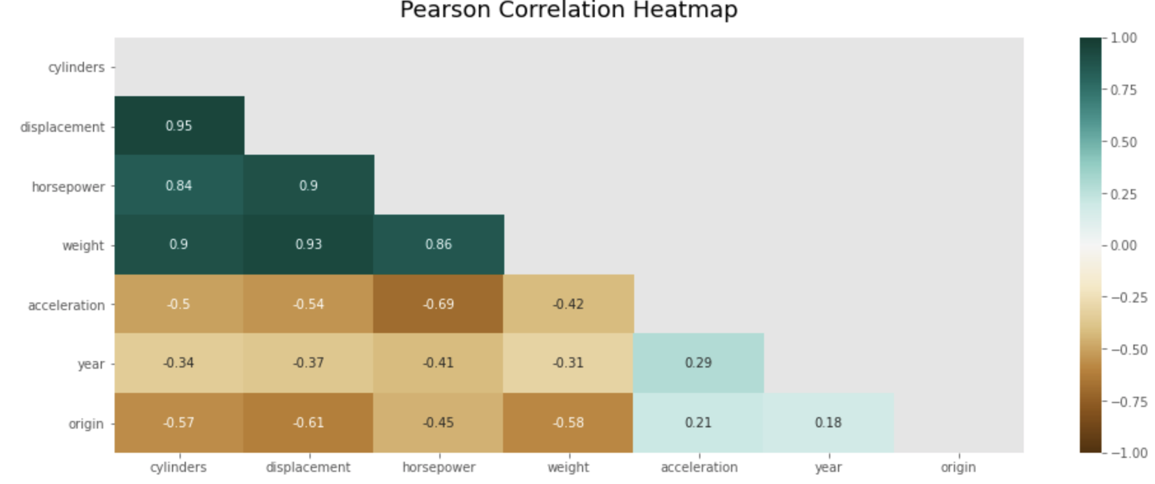
Auto MPG

Slide 8
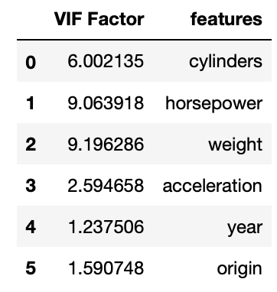
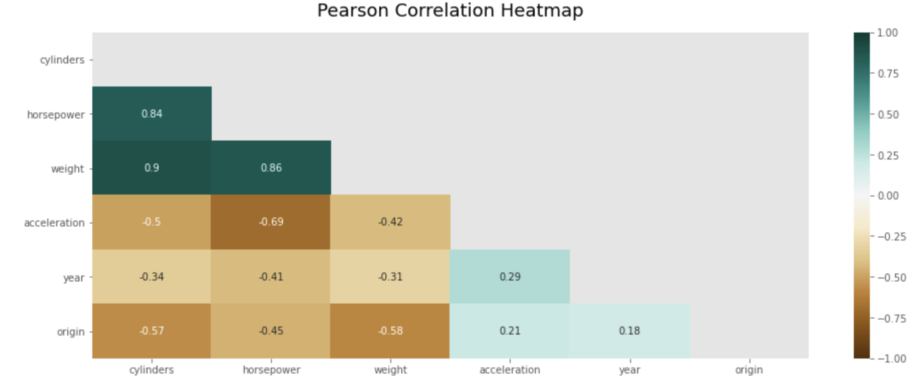
Auto MPG only ‘displacement’ is dropped, since no other feature with VIF > 10. Features with VIF > 5 will be considered to reduce SOC

Slide 9
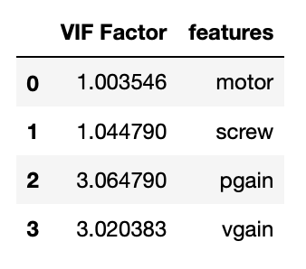
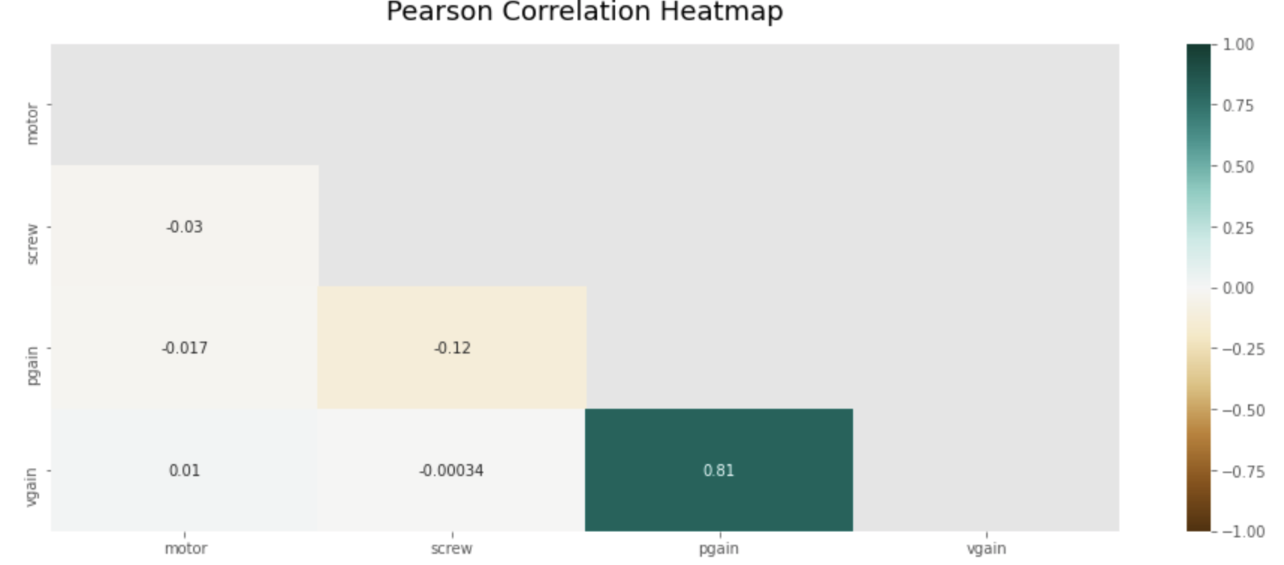
Servo all features are selected

